Slide 1


Applied Sciences
PT4050 and PT7001
Muscle Physiology Part 1
Chris Chamberlin and Dr Ben Hunter
c.chamberlin@londonmet.ac.uk

Slide 2
Learning Outcomes
Neuromuscular junction
Muscle structure
Contraction types
Cross-bridge formation
Motor units

Slide 3
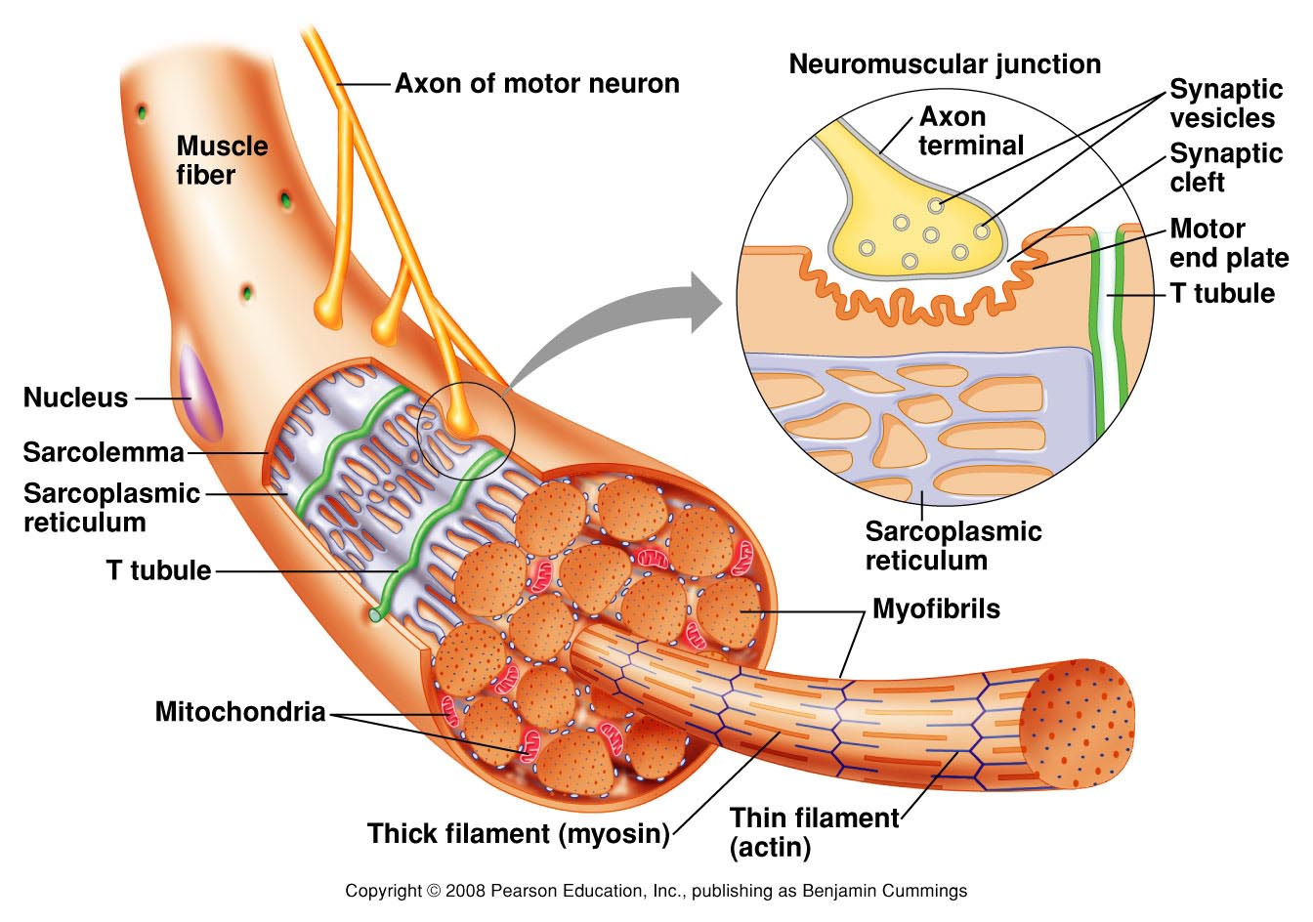
Structure
Sarcolemma: plasma membrane
Sarcoplasm: cytoplasm
Myofibrils
Mitochondria
Sarcoplasmic reticulum: smooth ER
Transverse tubule: T tubule)
Notes:
The sarcolemma surrounds the muscle fibre and allows the propogation of action potentials
Sarcoplasmic reticulum surround each myofibril and stores/releases calcium
Transverse tubular system invaginates into the muscle fibre from the surface and allows action potential to travel down it

Slide 4
Neuromuscular junction (NMJ)
Action potential to axon terminal of motor neuron
Ca²⁺ channels opens
Neurotransmitter acetylcholine (ACh) releases
Ligand-gated (Na⁺) channels open when ACh binds to the receptors on motor end plate
Action potential is generated when threshold is reached – All or Nothing Principle
Propagation of action potential on sarcolemma
Notes:
The sarcolemma surrounds the muscle fibre and allows the propogation of action potentials
Sarcoplasmic reticulum surround each myofibril and stores/releases calcium
Transverse tubular system invaginates into the muscle fibre from the surface and allows action potential to travel down it

Slide 5
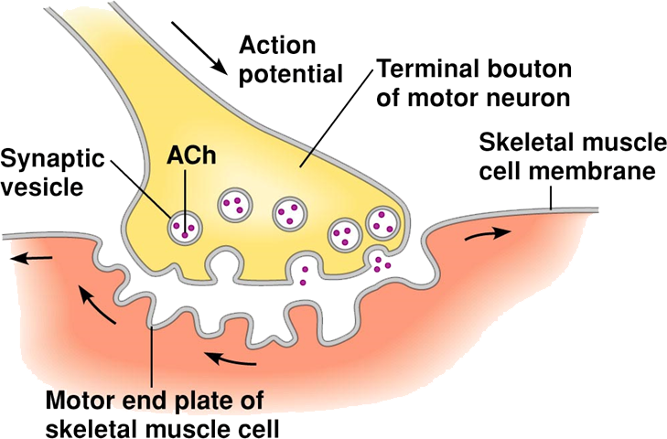
Neuromuscular junction (NMJ)

Slide 6
Excitation-contraction coupling
  ACh released at N -M J, receptor, AP
  Action potential down T tubules
  AP trigger Ca²⁺ release from SR
  Ca²⁺ binds to troponin exposing myosin binding site
  Crossbridge cycling occurs
  Ca²⁺ re-uptake actively
  Myosin binding sites blocked
Notes:
The sarcolemma surrounds the muscle fibre and allows the propogation of action potentials
Sarcoplasmic reticulum surround each myofibril and stores/releases calcium
Transverse tubular system invaginates into the muscle fibre from the surface and allows action potential to travel down it

Slide 7
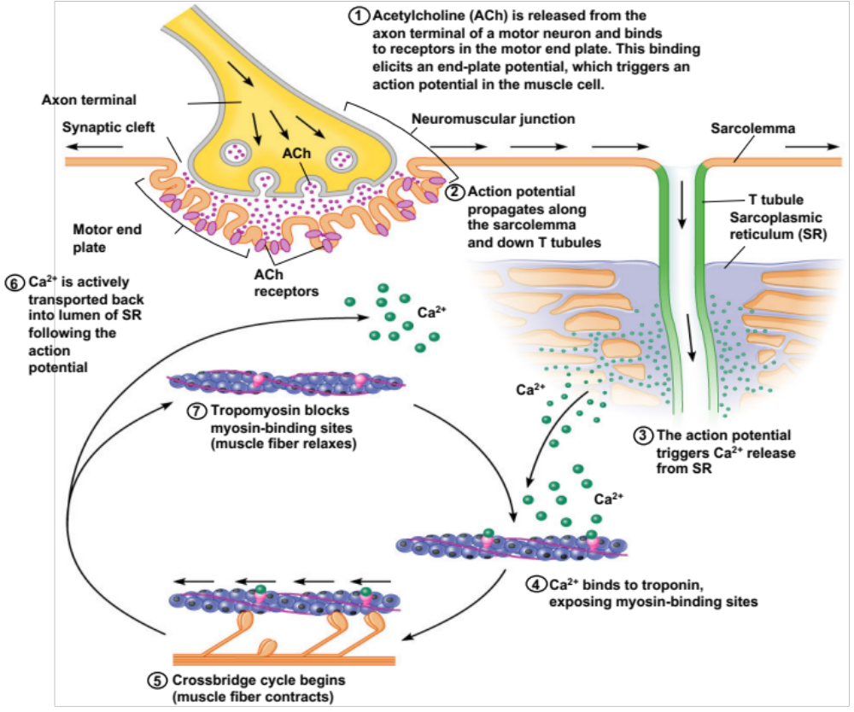

Slide 8
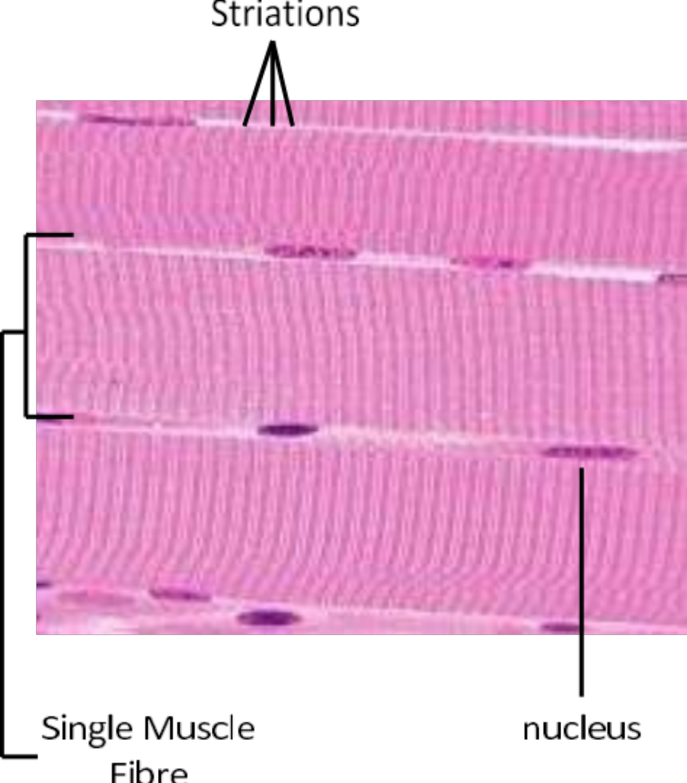
Striations
When viewed longitudinally, skeletal muscles have striations
Highly organised intracellular structures called myofibrils cause the striations
Notes:
The striated appearance of skeletal muscle tissue is a result of repeating bands of the proteins actin and myosin that are present along the length of myofibrils.

Slide 9
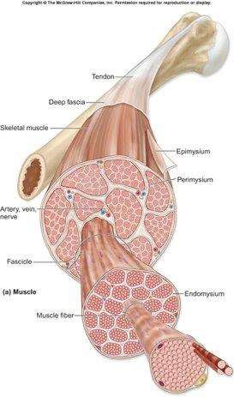
Structure
Levels of organisation
Epimysium (entire muscle)
Perimysium (approx. 150 fibres)
Endomysium (single fibre)
Muscle
Muscle Fibre
Myofibril
Myofilament
Notes:
In a copper electrical wire this is brought about by the movement of electrons along the wire. Air acts as the insulator.
The speed of action potentials conduction is slower than that of electricity along a wire

Slide 10
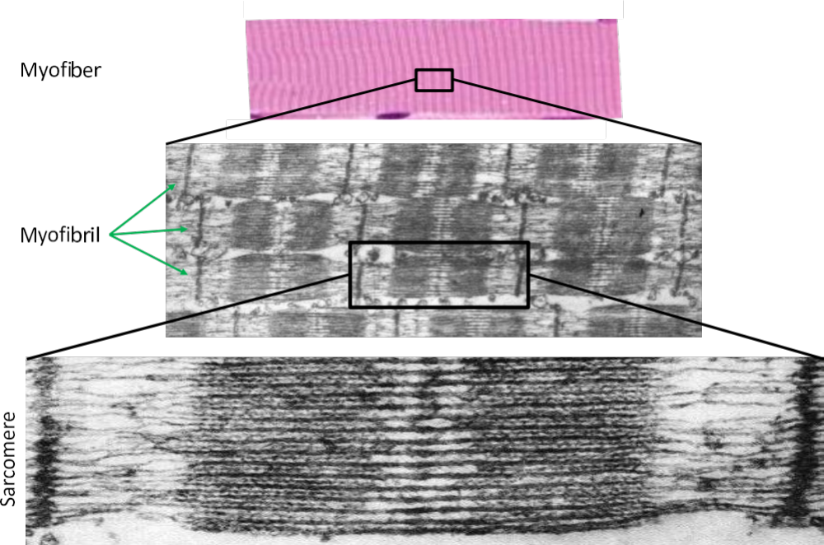
Striations
Notes:
The striated appearance of skeletal muscle tissue is a result of repeating bands of the proteins actin and myosin that are present along the length of myofibrils.

Slide 11
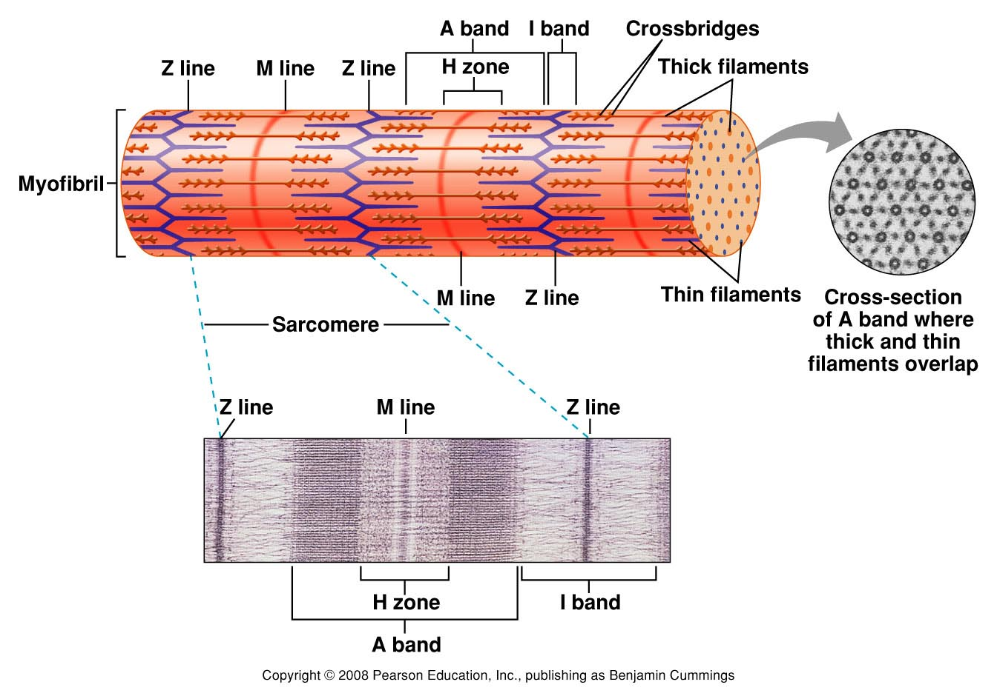
Structure of a myofibril / sarcomere
Notes:
Z-discs (Z-lines): These are protein structures that bisect the sarcomere, marking the boundaries between adjacent sarcomeres. They anchor the thin filaments (actin) and provide structural stability.
H-zone: This is the central region of the sarcomere where only myosin filaments are present. During muscle contraction, the H-zone narrows as the actin filaments slide inward.
A-band: The A-band is the dark region of the sarcomere that contains both actin and myosin filaments. It does not change in length during muscle contraction.
I-band: The I-band is the light region on either side of the A-band. It contains only actin filaments and gets narrower during muscle contraction.
M-line: This is a protein structure in the center of the sarcomere that helps hold the myosin filaments in place.

Slide 12
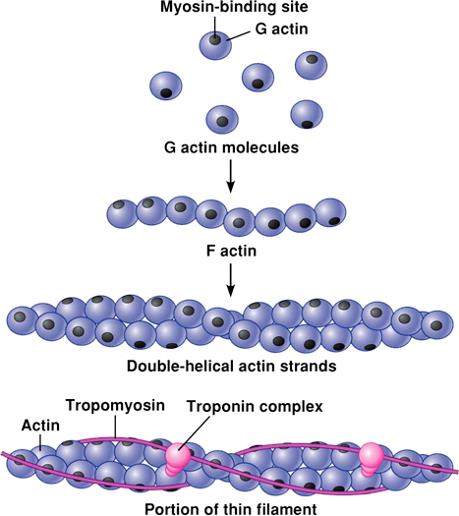
Myofilaments
  Actin - contractile protein
  Troponin – regulatory protein
  Tropomyosin – regulatory protein
Notes:
Actin: These are thin, thread-like structures composed primarily of the protein actin. Actin filaments are anchored to the Z-discs and extend towards the center of the sarcomere.These are thin, thread-like structures composed primarily of the protein actin. Actin filaments are anchored to the Z-discs and extend towards the center of the sarcomere.

Slide 13
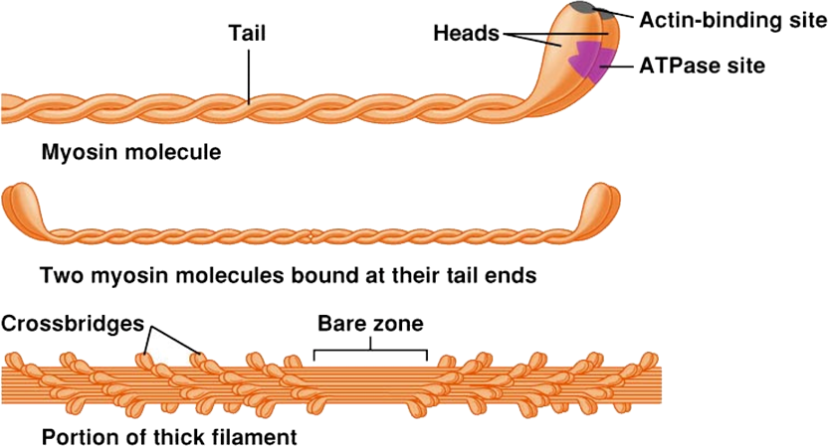
Myosin
Notes:
Myosin Filaments (Thick Filaments): These are thicker, club-shaped structures primarily composed of the protein myosin. Myosin filaments are located in the center of the sarcomere, overlapping with the actin filaments.

Slide 14
The crossbridge cycle
  Binding of myosin to actin
  Power stroke
  Rigor (low energy state)
  Unbinding of myosin and actin
  Cocking of myosin head (high energy state)
Notes:
Binding of Myosin to Actin:
In a resting muscle, the myosin heads are in a low-energy state, with an ADP and inorganic phosphate (Pi) molecule bound to them.
When a nerve signal triggers a muscle contraction, calcium ions are released, which expose the binding sites on the actin filaments.
The myosin heads then bind to these exposed sites on the actin, forming a cross-bridge.
Power Stroke:
After binding, the myosin head pivots, pulling the actin filament toward the center of the sarcomere. This movement is known as the power stroke.
As a result, the Z-discs move closer together, and the sarcomere shortens.
Rigor (Low Energy State):
After the power stroke, the myosin head is in a rigor state, tightly bound to actin.
In this state, ADP and Pi are still attached to the myosin head, but the myosin can't release the actin filament on its own.
Unbinding of Myosin and Actin:
To detach from actin, a new ATP molecule binds to the myosin head, causing it to detach from the actin binding site.
ATP binding also triggers a conformational change in the myosin head, which readies it for the next cycle.
Cocking of Myosin Head (High Energy State):
ATP is split into ADP and Pi, providing energy for the myosin head. This energy is used to "cock" or reposition the myosin head into a high-energy state.
This high-energy state positions the myosin head in a way that it's ready to bind to actin again once calcium ions are present and binding sites are exposed.

Slide 15
The crossbridge cycle
Notes:
Binding of Myosin to Actin:
In a resting muscle, the myosin heads are in a low-energy state, with an ADP and inorganic phosphate (Pi) molecule bound to them.
When a nerve signal triggers a muscle contraction, calcium ions are released, which expose the binding sites on the actin filaments.
The myosin heads then bind to these exposed sites on the actin, forming a cross-bridge.
Power Stroke:
After binding, the myosin head pivots, pulling the actin filament toward the center of the sarcomere. This movement is known as the power stroke.
As a result, the Z-discs move closer together, and the sarcomere shortens.
Rigor (Low Energy State):
After the power stroke, the myosin head is in a rigor state, tightly bound to actin.
In this state, ADP and Pi are still attached to the myosin head, but the myosin can't release the actin filament on its own.
Unbinding of Myosin and Actin:
To detach from actin, a new ATP molecule binds to the myosin head, causing it to detach from the actin binding site.
ATP binding also triggers a conformational change in the myosin head, which readies it for the next cycle.
Cocking of Myosin Head (High Energy State):
ATP is split into ADP and Pi, providing energy for the myosin head. This energy is used to "cock" or reposition the myosin head into a high-energy state.
This high-energy state positions the myosin head in a way that it's ready to bind to actin again once calcium ions are present and binding sites are exposed.

Slide 16
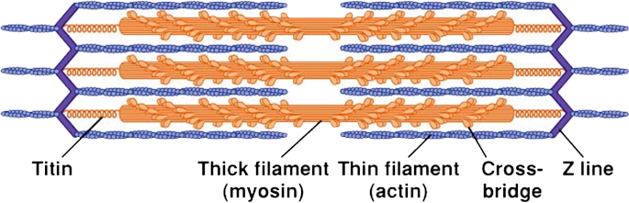
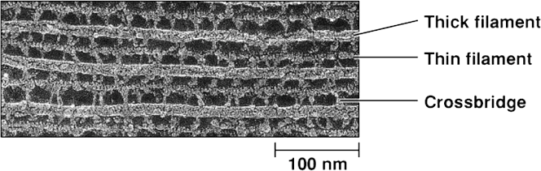
Sliding Filaments

Slide 17
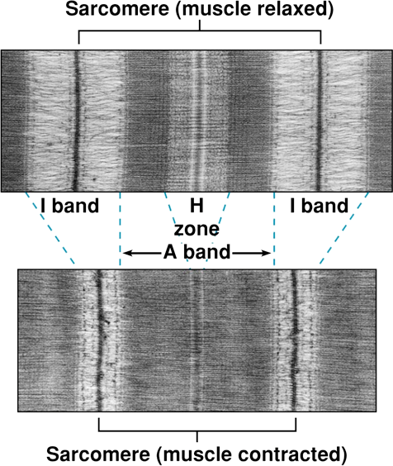
Sliding Filaments
  Myosin/actin filaments do not shorten
  A-band remains the same length
  I-band shortens
  H-band shortens

Slide 18
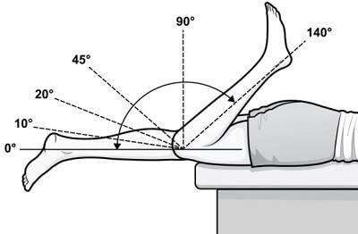
Length-Tension Relationship
Is there a position where maximum force can be generated?
What’s the relevance in physiotherapy?

Slide 19
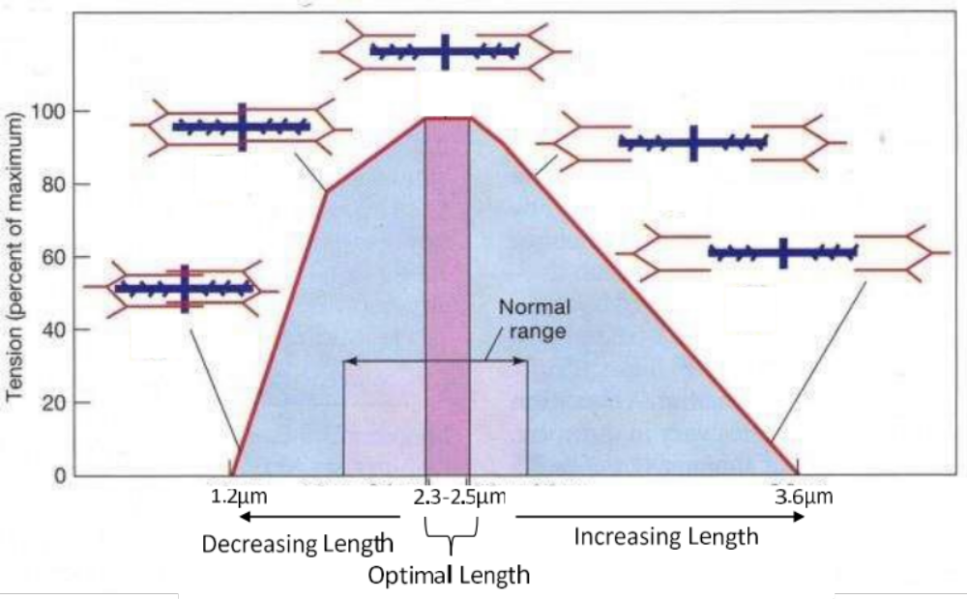
Length-Tension Relationship

Slide 20
Twitch contraction
  Contraction produced in response to a single action potential
  All or nothing for a given muscle fibre
  Can be induced for a muscle fibre, a motor unit or a whole muscle
  Latency: time delay between stimulation (nerve AP or direct electrical) – E-C coupling
  Contraction phase – cross-bridge cycling
  Relaxation phase – Ca²⁺ uptake

Slide 21
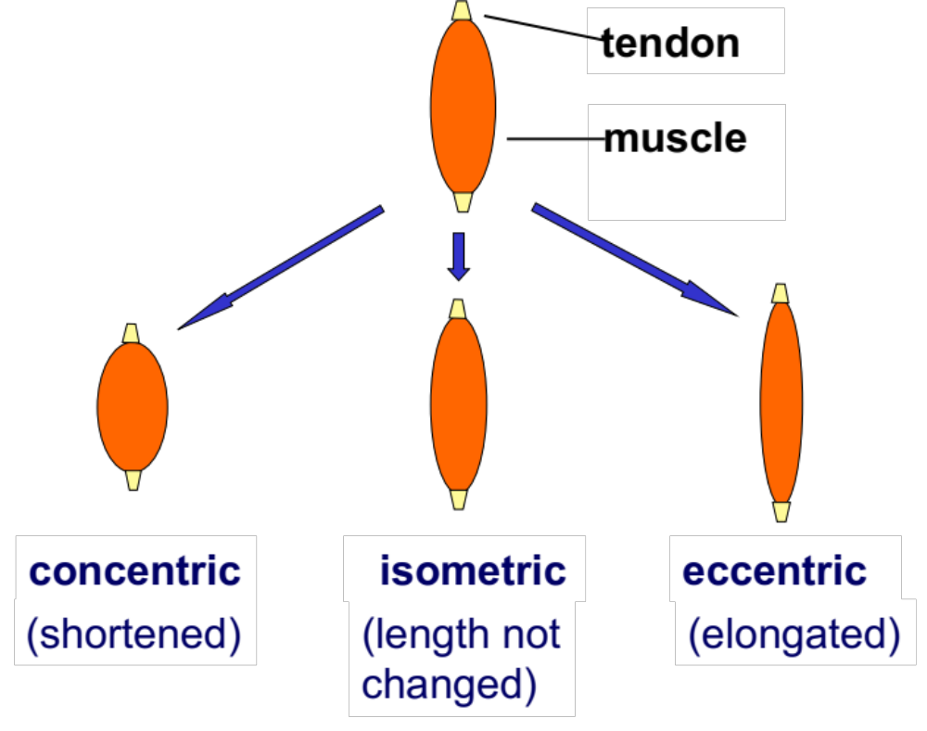
Types of muscle contraction
Easy to cause muscle damage
Notes:
The striated appearance of skeletal muscle tissue is a result of repeating bands of the proteins actin and myosin that are present along the length of myofibrils.

Slide 22
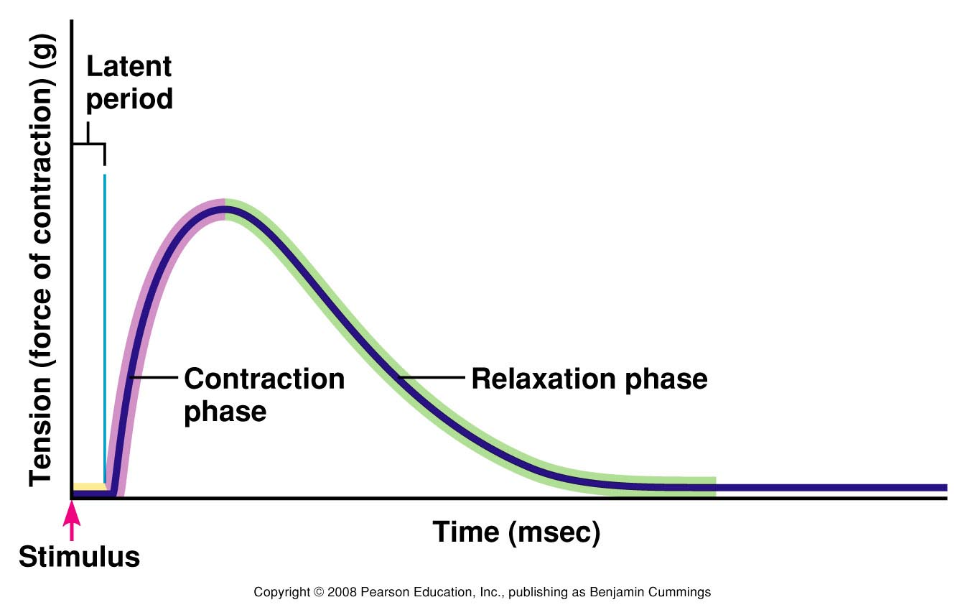
Twitch contraction
Notes:
Nervous Stimulation: A twitch occurs when a nerve impulse (action potential) stimulates a motor neuron, which in turn signals a specific muscle fiber to contract.
Phases of a Twitch:
Latent Phase: This is the brief moment between the nerve impulse and the onset of muscle contraction. It represents the time taken for the action potential to travel along the nerve and initiate the muscle response.
Contraction Phase: This is when the muscle fiber actively shortens and generates force.
Relaxation Phase: After the contraction, the muscle fiber returns to its original length, and tension decreases.
Strength and Duration: The strength and duration of a twitch are relatively constant and do not vary greatly under normal physiological conditions.

Slide 23
Frequency and Summation
  Action potential: 2 ms
  Contraction: 10–200 ms, possible to summate
  Tension (force) depends on [Ca²⁺]_{i}
  Freq. of stim.↑, Ca²⁺ release>uptake, [Ca²⁺]_{i}↑
  When the system is saturated (all troponin bind with Ca²⁺ and cross-bridge cycling maxed out) – tetanus (long lasting contraction)

Slide 24
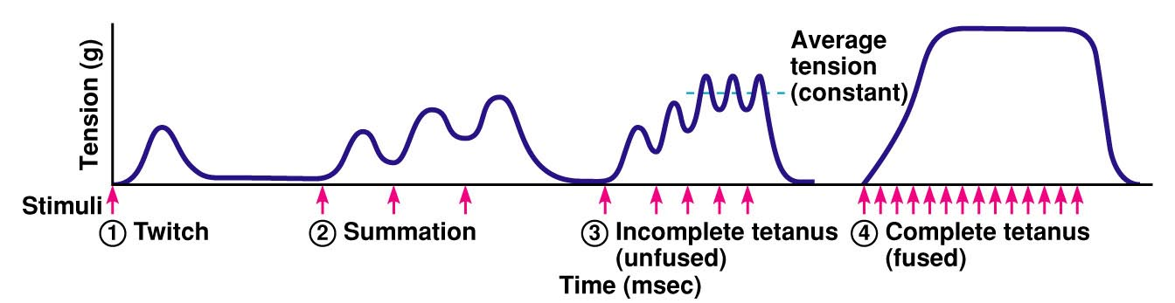
Frequency and Summation
Notes:
Summation and tetanus are processes by which muscle fibers can produce sustained contractions.
They occur when muscle fibers receive repeated nerve impulses in a short period of time.
Summation: This occurs when a single motor neuron repeatedly sends action potentials in quick succession to a muscle fiber. If the impulses are frequent enough, the muscle fiber doesn't have enough time to completely relax between contractions. As a result, the force of each contraction adds up, leading to a more sustained, stronger contraction.
Incomplete Tetanus: In this state, the muscle fiber is stimulated at a rapid rate, but there is still a partial relaxation between contractions. The result is a sustained but not entirely steady level of muscle tension.
Complete Tetanus (Fused Tetanus): When the stimulation frequency is so high that the muscle fiber doesn't have time to relax at all between contractions, a complete tetanus occurs. The contractions fuse together, resulting in a sustained, smooth, and maximal level of muscle tension.
Physiological Tetanus: This is a sustained muscle contraction that occurs during normal, everyday activities. It's the result of repeated motor neuron signaling to muscle fibers.
Pathological Tetanus: This is an uncontrolled, sustained muscle contraction often caused by the toxin produced by the bacterium Clostridium tetani. It leads to severe muscle rigidity.

Slide 25
Types of muscle contraction
  Isometric contraction
    Muscle does not shorten
    No work is done
    Load > tension
  Isotonic contraction
    Constant force
    Work is being done
    Load < tension
Notes:
The striated appearance of skeletal muscle tissue is a result of repeating bands of the proteins actin and myosin that are present along the length of myofibrils.

Slide 26
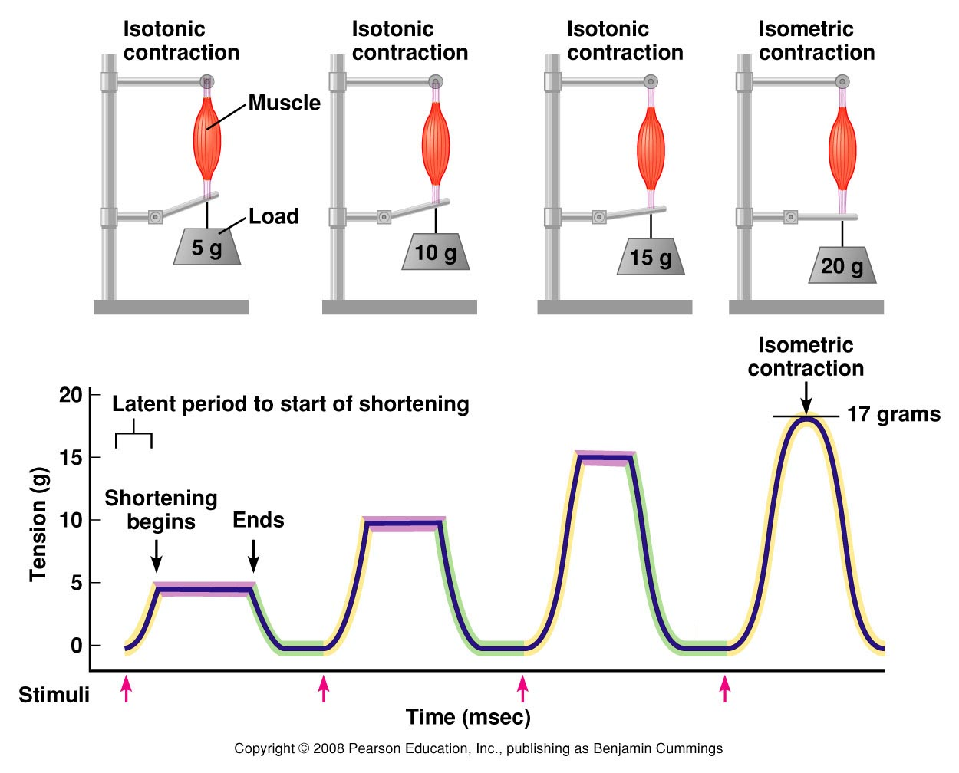
Types of muscle contraction
Notes:
The striated appearance of skeletal muscle tissue is a result of repeating bands of the proteins actin and myosin that are present along the length of myofibrils.

Slide 27
Concentric vs. Eccentric contraction
  Both involve changes in muscle length
  Concentric contraction:
    The muscle contracts and shortens (does work)
Eccentric contraction:
  The muscle generates force as it lengthens absorb energy - puts the body in position to contract concentrically
Quadriceps in squat:
  eccentric – isometric – concentric
Notes:
The striated appearance of skeletal muscle tissue is a result of repeating bands of the proteins actin and myosin that are present along the length of myofibrils.

Slide 28
Measurement Methods
Isometric Muscle Strength Testing
Isokinetic Muscle Testing
Handheld Dynamometry
Manual Muscle Testing (MMT)
Electromyography (EMG)
Muscle Biopsy
Ultrasound Imaging
Force Plate Analysis
Notes:
ometric Muscle Strength Testing:
In this method, the muscle contracts against an immovable resistance. It's commonly used to measure static strength and assess the maximum force a muscle or muscle group can generate at a specific joint angle.
Isokinetic Muscle Testing:
Isokinetic testing involves dynamic movements against a constant speed of resistance. It measures both concentric (muscle shortening) and eccentric (muscle lengthening) strength. Specialized isokinetic machines are used for this purpose.
Handheld Dynamometry:
This involves using a handheld device (dynamometer) to measure muscle force. It's particularly useful for assessing muscle strength in a clinical setting, as it's portable and allows for quick measurements.
Manual Muscle Testing (MMT):
MMT is a subjective assessment conducted by a trained examiner. It involves applying resistance against a specific muscle group's movement to grade its strength on a scale (e.g., from 0 to 5).
Electromyography (EMG):
EMG measures the electrical activity of muscles during contraction. Electrodes are placed on the skin or inserted into the muscle to record and analyze the muscle's electrical signals. This method provides insights into muscle activation patterns and timing.
Muscle Biopsy:
A muscle biopsy involves the removal of a small sample of muscle tissue for examination under a microscope. This method is used to study muscle fiber type composition, structure, and potential abnormalities.
Ultrasound Imaging:
Ultrasound can be used to assess muscle size, architecture, and composition. It's non-invasive and provides real-time images of muscle tissue.
Force Plate Analysis:
Force plates measure the ground reaction forces produced during movements. This method is used to analyze factors like balance, gait, and the force exerted by muscles during dynamic activities.

Slide 29
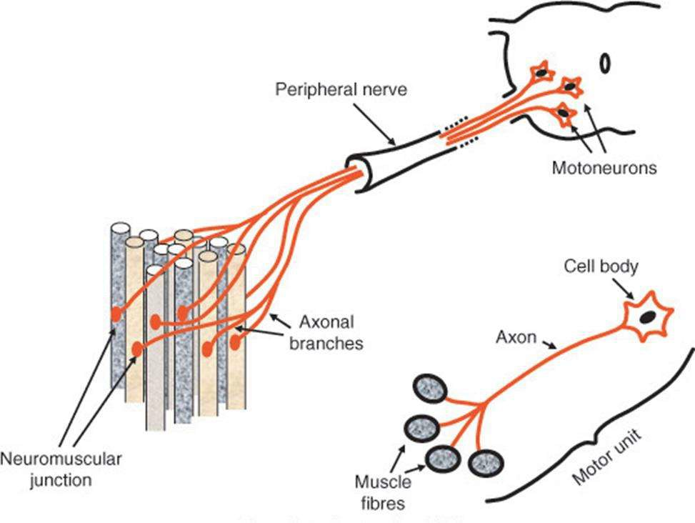
The Motor Unit
  One motor neuron innervates many fibres
  One fibre innervated by only one neuron
  Same type of fibres within the motor unit
  All the muscle fibres in a motor unit will simultaneously contract when it “fires”
A motor unit is a motoneuron axon and all the muscle fibres it innervates

Slide 30
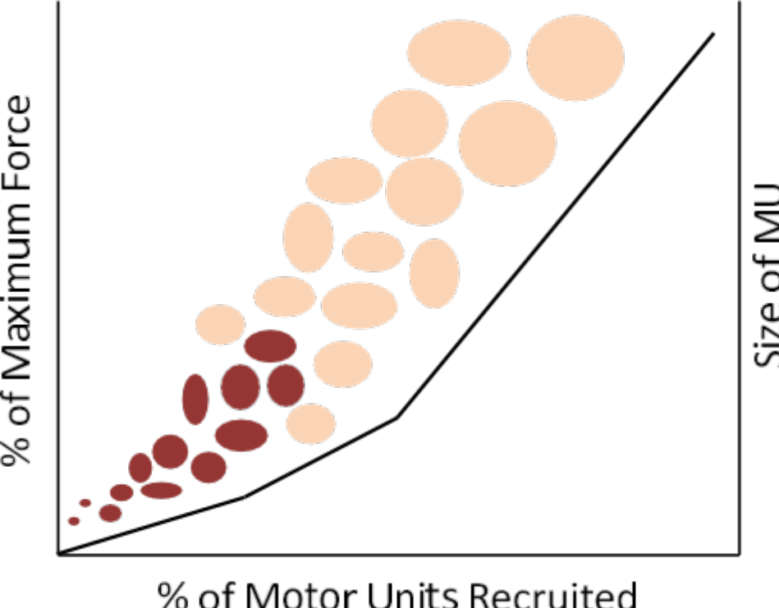
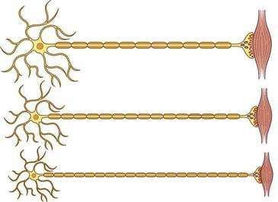



Recruitment
  MU recruitment occurs in a specific order according to Henneman’s size principle
  Once one MU is activated, all fibres within the MU will contract maximally
  Smallest MUs recruited first (type I)
  Largest MUs recruited last (type II)
Notes:
Gradation of Muscle Force:
Motor unit recruitment allows for fine control over muscle force production.
Smaller, weaker motor units are recruited first for lighter tasks.
As the demand for force increases, larger, stronger motor units are progressively activated.
All-or-None Principle within Motor Units:
Once a motor unit is activated, all the muscle fibers it innervates contract maximally (the all-or-none principle).
To generate greater force, the nervous system recruits additional motor units.
Precision and Adaptability:
Motor unit recruitment enables precise control of movement and adaptability to varying demands.
Delicate tasks (e.g., typing) use fewer and smaller motor units, while forceful tasks (e.g., lifting) engage more and larger motor units.

Slide 31
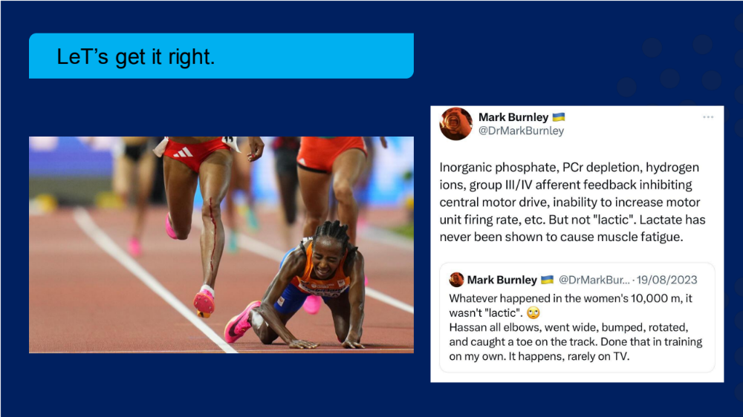
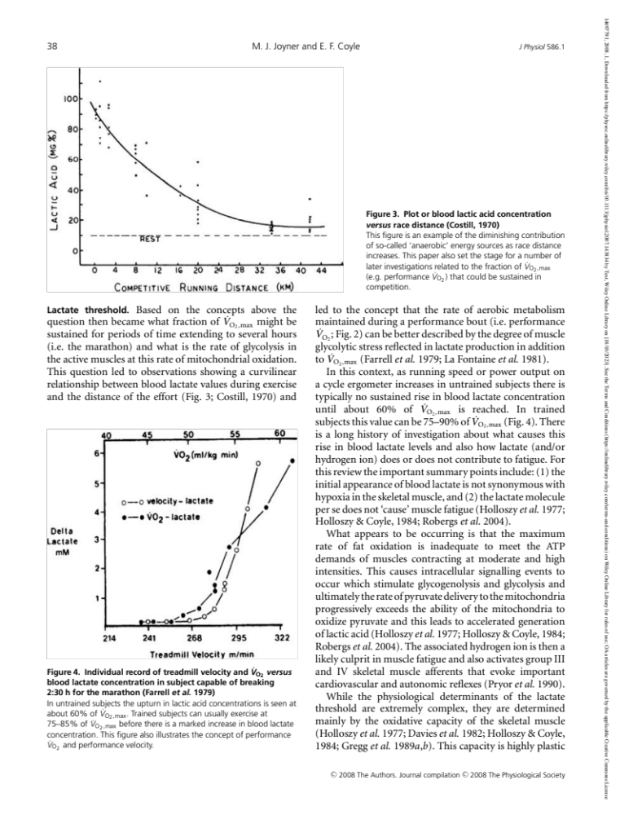
Just to get this right…
Notes:
The conversion of pyruvate to lactate results in the release of hydrogen ions (H+). These ions contribute to the increase in acidity (lower pH) in the muscle tissue and bloodstream, a condition known as acidosis.

Slide 32
Summary
See learning outcomes.

